Slide 1
Divide & Conquer

Slide 2
Divide and Conquer Algorithms
  Example
    Binary Search
    Merge Sort
    Quick Sort
    Counting
    Closest Pair of Points

Slide 3
Divide and Conquer
Divide the problem into a number of subproblems
  There must be base case (to stop recursion).
Conquer (solve) each subproblem recursively
Combine (merge) solutions to subproblems into a solution to the original problem

Slide 4
Divide-and-Conquer
Most common usage.
  Break up problem of size n into two equal parts of size ½n.
  Solve two parts recursively.
  Combine two solutions into overall solution in linear time.
Consequence.
  Brute force: n².
  Divide-and-conquer: n log n.

Slide 5
Mergesort

Slide 6
Mergesort
Mergesort.
  Divide array into two halves.
  Recursively sort each half.
  Merge two halves to make sorted whole.
A
L
G
O
R
I
T
H
M
S
A
L
G
O
R
I
T
H
M
S
divide
O(1)
A
G
L
O
R
H
I
M
S
T
sort
2T(n/2)
A
G
H
I
L
M
O
R
S
T
merge
O(n)

Slide 7
Merging
Merging. Combine two pre-sorted lists into a sorted whole.
How to merge efficiently?
  Linear number of comparisons.
  Use temporary array.
A
G
L
O
R
H
I
M
S
T
A
G
H
I

Slide 8
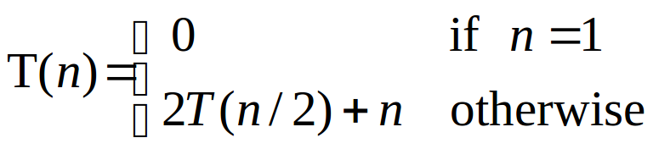
A Useful Recurrence Relation
Def. T(n) = number of comparisons to mergesort an input of size n.
Mergesort recurrence.
Solution. T(n) = O(n log₂ n).
Assorted proofs. We describe several ways to prove this recurrence. Initially we assume n is a power of 2 and replace ≤ with =.

Slide 9
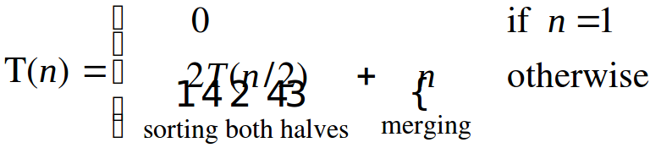
Proof by Recursion Tree
T(n)
n
T(n/2)
T(n/2)
2(n/2)
T(n/4)
T(n/4)
T(n/4)
T(n/4)
4(n/4)
log₂n
. . .
T(n / 2^{k})
2^{k} (n / 2^{k})
. . .
T(2)
T(2)
T(2)
T(2)
T(2)
T(2)
T(2)
T(2)
n/2 (2)
n log₂n

Slide 10
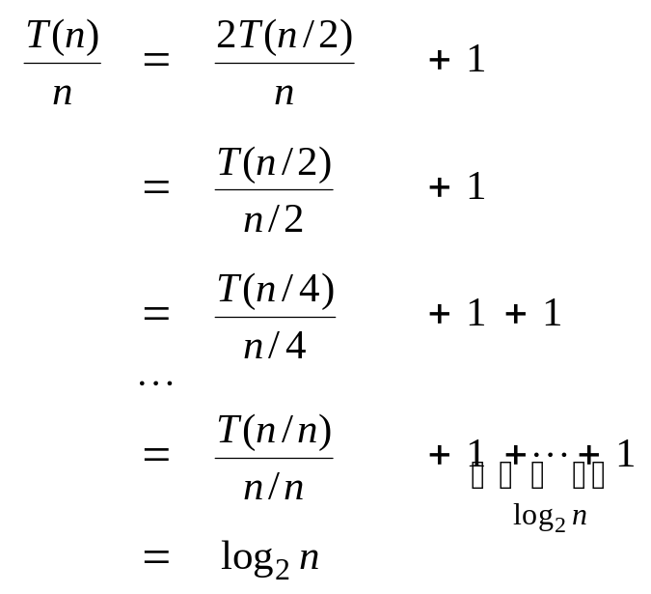
Proof by Telescoping
Claim. If T(n) satisfies this recurrence, then T(n) = n log₂ n.
Pf. For n > 1:
assumes n is a power of 2

Slide 11
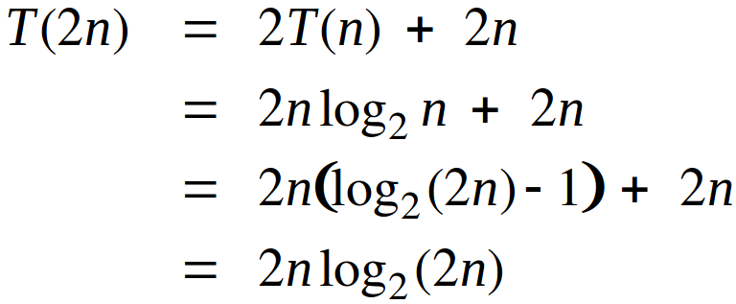
Proof by Induction
Claim. If T(n) satisfies this recurrence, then T(n) = n log₂ n.
Pf. (by induction on n)
  Base case: n = 1.
  Inductive hypothesis: T(n) = n log₂ n.
  Goal: show that T(2n) = 2n log₂ (2n).
assumes n is a power of 2

Slide 12
Merging
Merge.
  Keep track of smallest element in each sorted half.
  Insert smallest of two elements into auxiliary array.
  Repeat until done.
smallest
smallest
A
G
L
O
R
H
I
M
S
T
A
auxiliary array

Slide 13
Merging
Merge.
  Keep track of smallest element in each sorted half.
  Insert smallest of two elements into auxiliary array.
  Repeat until done.
smallest
smallest
A
G
L
O
R
H
I
M
S
T
A
G
auxiliary array

Slide 14
Merging
Merge.
  Keep track of smallest element in each sorted half.
  Insert smallest of two elements into auxiliary array.
  Repeat until done.
smallest
smallest
A
G
L
O
R
H
I
M
S
T
A
G
H
auxiliary array

Slide 15
Merging
Merge.
  Keep track of smallest element in each sorted half.
  Insert smallest of two elements into auxiliary array.
  Repeat until done.
smallest
smallest
A
G
L
O
R
H
I
M
S
T
A
G
H
I
auxiliary array

Slide 16
Merging
Merge.
  Keep track of smallest element in each sorted half.
  Insert smallest of two elements into auxiliary array.
  Repeat until done.
smallest
smallest
A
G
L
O
R
H
I
M
S
T
A
G
H
I
L
auxiliary array

Slide 17
Merging
Merge.
  Keep track of smallest element in each sorted half.
  Insert smallest of two elements into auxiliary array.
  Repeat until done.
smallest
smallest
A
G
L
O
R
H
I
M
S
T
A
G
H
I
L
M
auxiliary array

Slide 18
Merging
Merge.
  Keep track of smallest element in each sorted half.
  Insert smallest of two elements into auxiliary array.
  Repeat until done.
smallest
smallest
A
G
L
O
R
H
I
M
S
T
A
G
H
I
L
M
O
auxiliary array

Slide 19
Merging
Merge.
  Keep track of smallest element in each sorted half.
  Insert smallest of two elements into auxiliary array.
  Repeat until done.
smallest
smallest
A
G
L
O
R
H
I
M
S
T
A
G
H
I
L
M
O
R
auxiliary array

Slide 20
Merging
Merge.
  Keep track of smallest element in each sorted half.
  Insert smallest of two elements into auxiliary array.
  Repeat until done.
first half
exhausted
smallest
A
G
L
O
R
H
I
M
S
T
A
G
H
I
L
M
O
R
S
auxiliary array

Slide 21
Merging
Merge.
  Keep track of smallest element in each sorted half.
  Insert smallest of two elements into auxiliary array.
  Repeat until done.
first half
exhausted
smallest
A
G
L
O
R
H
I
M
S
T
A
G
H
I
L
M
O
R
S
T
auxiliary array

Slide 22
Merging
Merge.
  Keep track of smallest element in each sorted half.
  Insert smallest of two elements into auxiliary array.
  Repeat until done.
first half
exhausted
second half
exhausted
A
G
L
O
R
H
I
M
S
T
A
G
H
I
L
M
O
R
S
T
auxiliary array

Slide 23
Counting Inversions

Slide 24
Counting Inversions
Music site tries to match your song preferences with others.
  You rank n songs.
  Music site consults database to find people with similar tastes.
Similarity metric: number of inversions between two rankings.
  My rank: 1, 2, …, n.
  Your rank: a₁, a₂, …, a_{n}.
  Songs i and j inverted if i <= j, but a_{i} > a_{j}.
Brute force: check all Θ(n²) pairs i and j.
Songs
A
B
C
D
E
Me
1
2
3
4
5
Inversions
3-2, 4-2
You
1
3
4
2
5
Notes:
amazon.com, launch.com, restaurants, movies, . . .
Note: there can be a quadratic number of inversions.
Asymptotically faster algorithm must compute total number without even looking at each inversion individually.

Slide 25
Counting Inversions: Divide-and-Conquer
Divide-and-conquer.
1
5
4
8
10
2
6
9
12
11
3
7

Slide 26
Counting Inversions: Divide-and-Conquer
Divide-and-conquer.
  Divide: separate list into two pieces.
1
5
4
8
10
2
6
9
12
11
3
7
Divide: O(1).
1
5
4
8
10
2
6
9
12
11
3
7

Slide 27
Counting Inversions: Divide-and-Conquer
Divide-and-conquer.
  Divide: separate list into two pieces.
  Conquer: recursively count inversions in each half.
1
5
4
8
10
2
6
9
12
11
3
7
Divide: O(1).
1
5
4
8
10
2
6
9
12
11
3
7
Conquer: 2T(n / 2)
5 blue-blue inversions
8 green-green inversions
5-4, 5-2, 4-2, 8-2, 10-2
6-3, 9-3, 9-7, 12-3, 12-7, 12-11, 11-3, 11-7

Slide 28
Counting Inversions: Divide-and-Conquer
Divide-and-conquer.
  Divide: separate list into two pieces.
  Conquer: recursively count inversions in each half.
  Combine: count inversions where a_{i} and a_{j} are in different halves, and return sum of three quantities.
1
5
4
8
10
2
6
9
12
11
3
7
Divide: O(1).
1
5
4
8
10
2
6
9
12
11
3
7
Conquer: 2T(n / 2)
5 blue-blue inversions
8 green-green inversions
9 blue-green inversions
5-3, 4-3, 8-6, 8-3, 8-7, 10-6, 10-9, 10-3, 10-7
Combine: ???
Total = 5 + 8 + 9 = 22.

Slide 29
Counting Inversions: Divide-and-Conquer
How can we combine the results in O(n) time?
!!!Try Yourself!!!

Slide 30
!!!Try Yourself!!! – Algorithm to find MAX from an array
Derive an Divide & Conquer algorithm to find the MAX from an array of N elements and find the complexity of your algorithm.

Slide 32
!!!Try Yourself !!! - Two Dimensional Search
You are given an m × n matrix of numbers A, sorted in increasing order within rows and within columns. Assume m = O(n). Design an algorithm that finds the location of an arbitrary value x, in the matrix or report that the item is not present. Is your algorithm optimal?

